Slide 1
Efficient Video Processing: Don’t process the same thing twice!
Amir Habibian
Senior Staff Engineer Manager
Qualcomm AI Research
Qualcomm AI Research is an initiative of Qualcomm Technologies, Inc.

Slide 2
Efficient Video Processing
Information grows sub-linearly in a sequence of video frames
Can deep NNs adjust computations to be proportionate to the frame content?
Temporal Redundancies
Reduce data
Reduce model
@Pixel
@Region
@Frame
@Block
@Backbone

Slide 3
Temporal Redundancies
Reduce data
Reduce model
@Pixel
@Region
@Frame
@Block
@Backbone
Skip-Convolutions for Efficient Video Processing
Amirhossein Habibian, Davide Abati, Taco S. Cohen, Babak Ehteshami Bejnordi
CVPR 2021

Slide 4
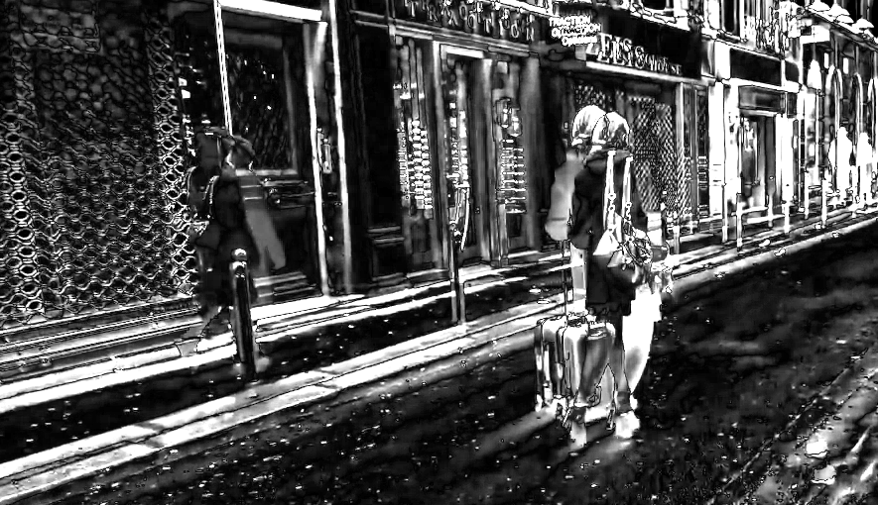
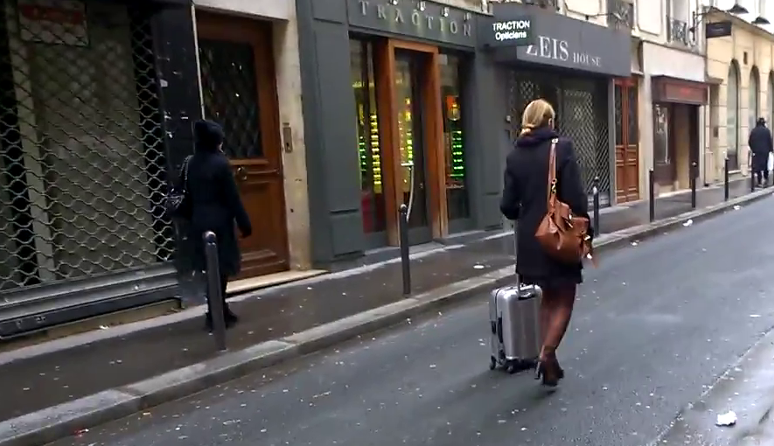
Convolution on residual frames
$$x_{t−1}$$
$$r_{t}$$
$$x_{t}$$
+
=
Convolve with kernel $w:$
$$w∗x_{t−1}$$
+
$$w∗r_{t}$$
=
$$w∗x_{t}$$
Convolution output on frame $x_{t−1}$
(precomputed)
Convolution output on residual frame $r_{t}$
(sparse, efficient)
Convolution output on frame $x_{t}$

Slide 5
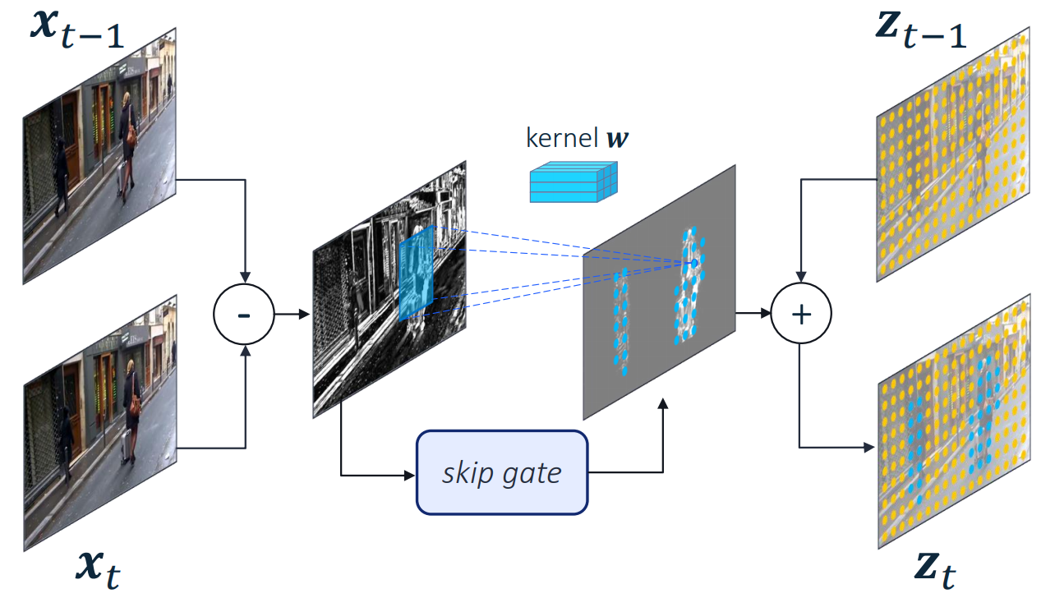
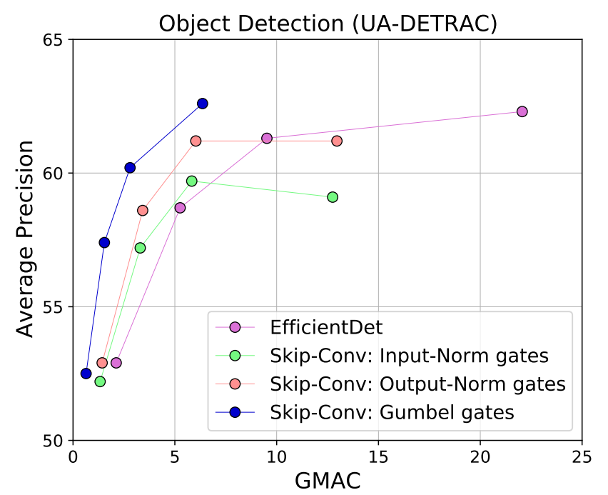
Skip-Convolution: enforcing sparsity with binary gates
Compute residual $r_{t}$.
Estimate binary gates $g(r_{t})$.
Sparse convolution on residual frame $r_{t}$, in locations specified by gates.
Update output representation $z_{t−1}$ to $z_{t}$.
Repeat in every convolutional layer.
NORM GATES
GUMBEL GATES
$$g\left(r_{t},φ\right)=round(σ(f(r_{t}, φ)))$$
$$g\left(r_{t},ε\right)=round(σ({\left\|r_{t}\right\|}_{p}−ε))$$
Sparsity enforced with loss
No training needed: can be applied to any pretrained network to save computation.
$$ℒ_{gate}\left(φ\right)=β\frac{1}{T−1}\sum_{t=2}^{T}{𝔼(g\left(r_{t},φ\right))}$$

Slide 6
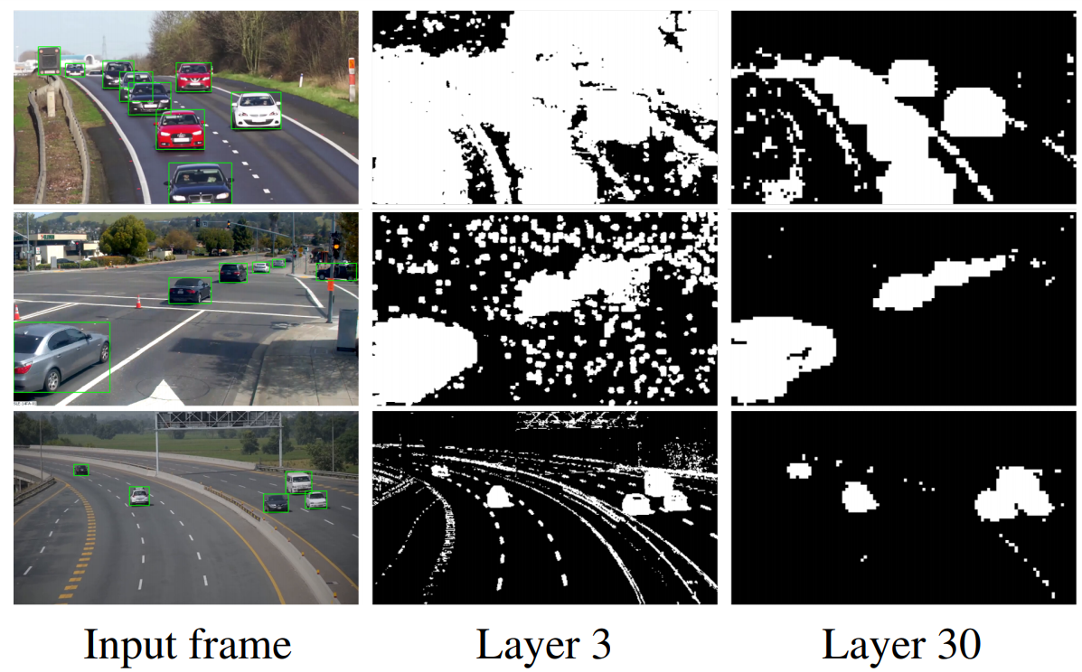
Results: video object detection
Gates become more selective at a deeper layer

Slide 7
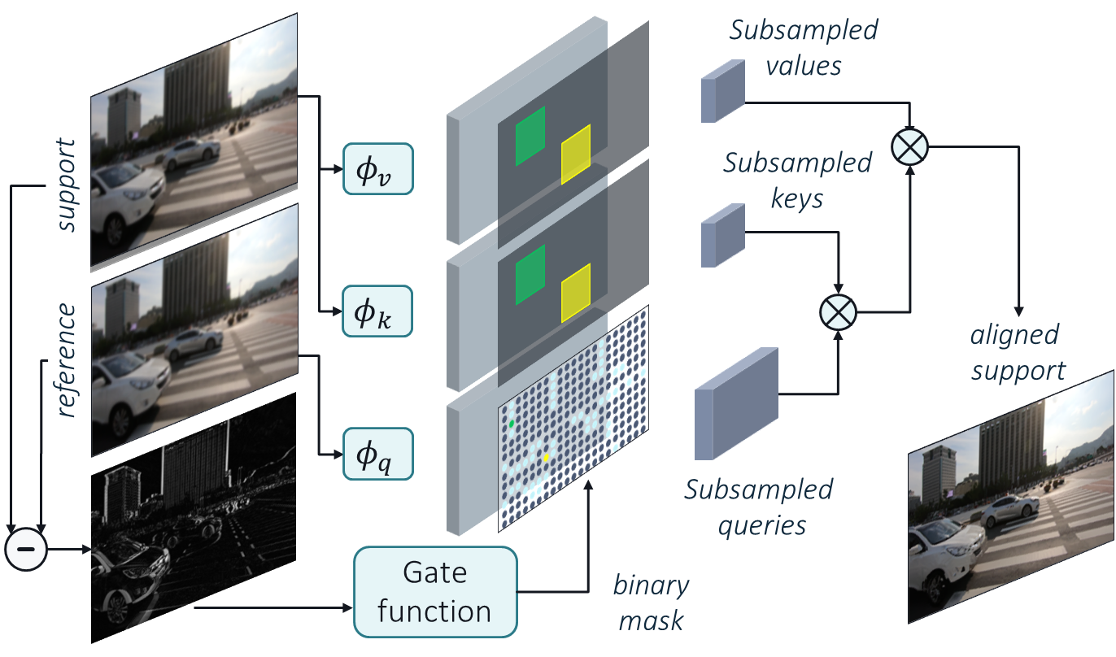
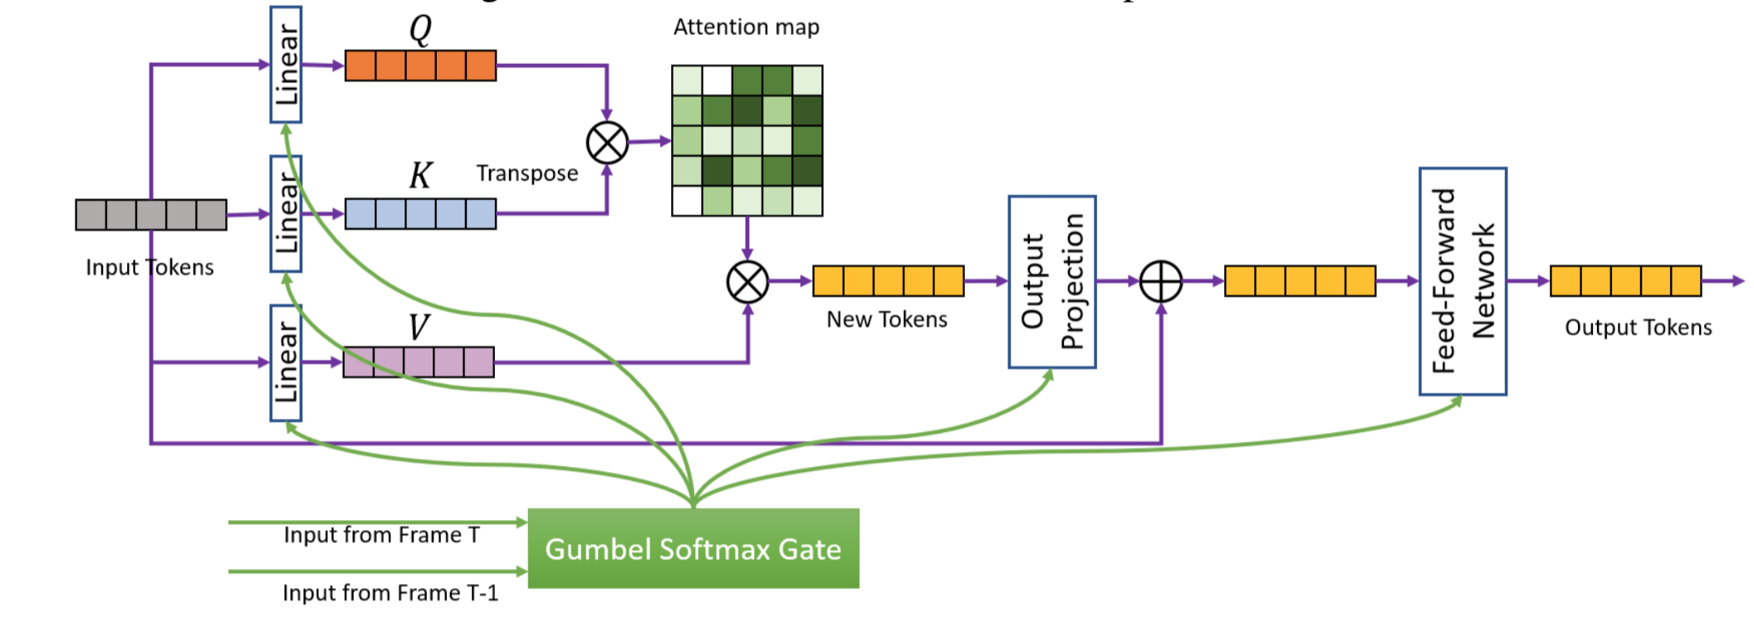
From CNNs to Transformers
Spatio-Temporal Gated Transformers for Efficient Video Processing, Li et al.
Efficient Video Super Resolution by Gated Local Self Attention, Abati et al.
Subsample query only on moving tokens
Reduce self attention cost used as alignment op
Video enhancements tasks such as super-res
Skip processing of tokens:
KQV projections
Feed-forward network
Ternary gates

Slide 8
Temporal Redundancies
Reduce data
Reduce model
@Pixel
@Region
@Frame
@Block
@Backbone
Saliency-based Input Sampling for Efficient Video Object Detection
Babak Ehteshami Bejnordi, Amir Ghodrati, Fatih Porikli, Amirhossein Habibian
ECCV submission

Slide 9
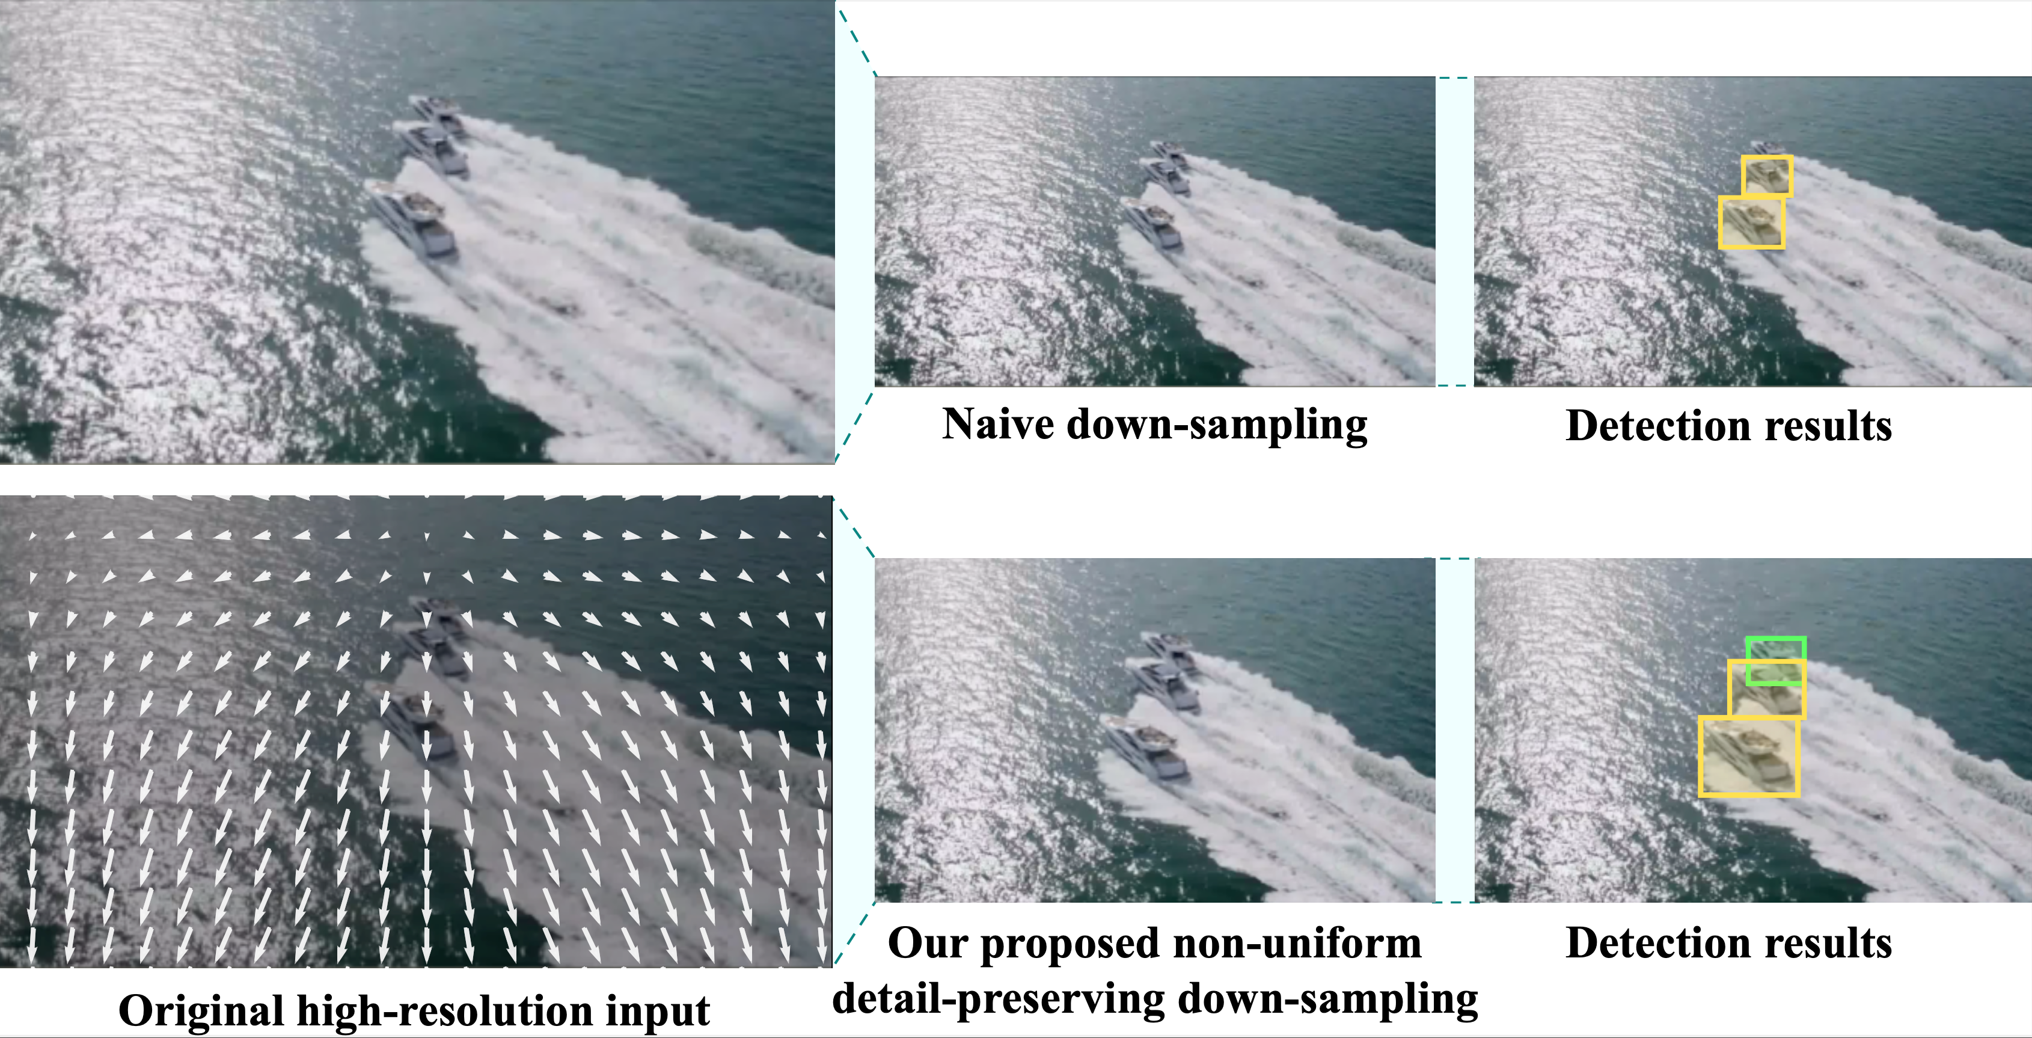
Efficient object detection
The rise in the quality of image capturing devices such as 4K cameras
Enables the detection of most detailed video contents
Comes with increased computational costs
Naïve down-sampling of the input quickly degrades the performance:
2x down-sampling degrades average precision from 52.6% to 47.6% on MS-COCO using EfficientDet-D6
Propose a non-uniform input sampling that retains the details at certain regions
Regions with low confidence prediction or small objects

Slide 10
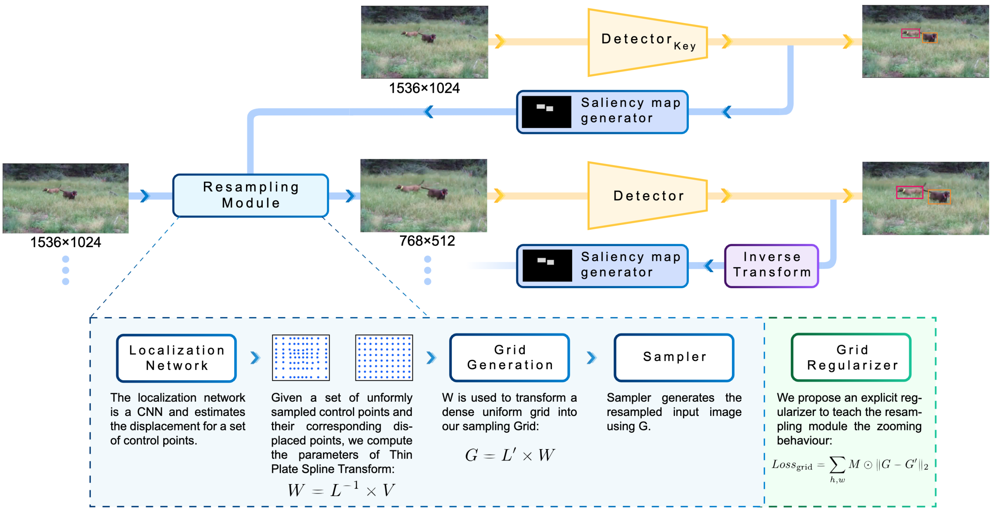
SALISA: Saliency-based Input Sampling
Overview

Slide 11
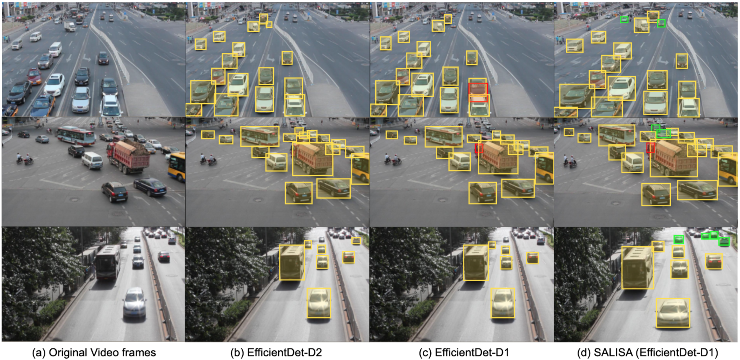
Evaluation

Slide 12
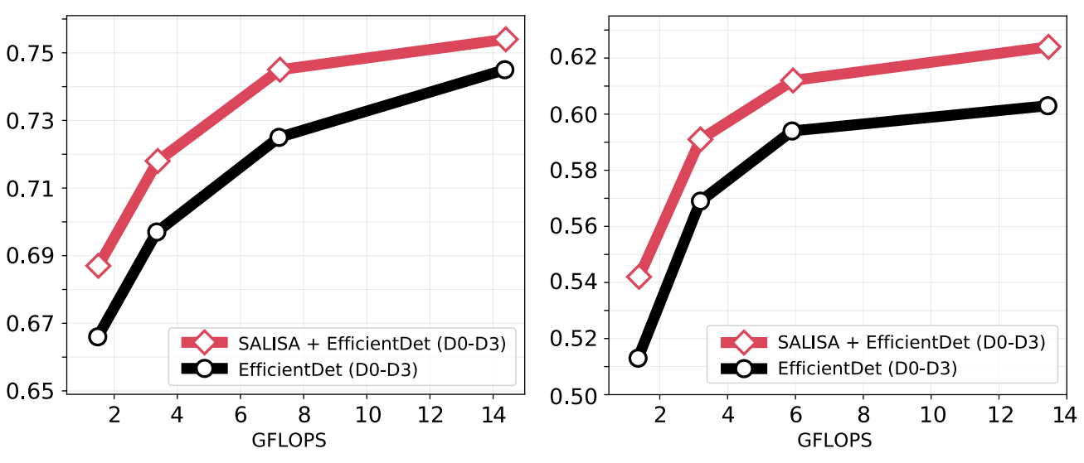
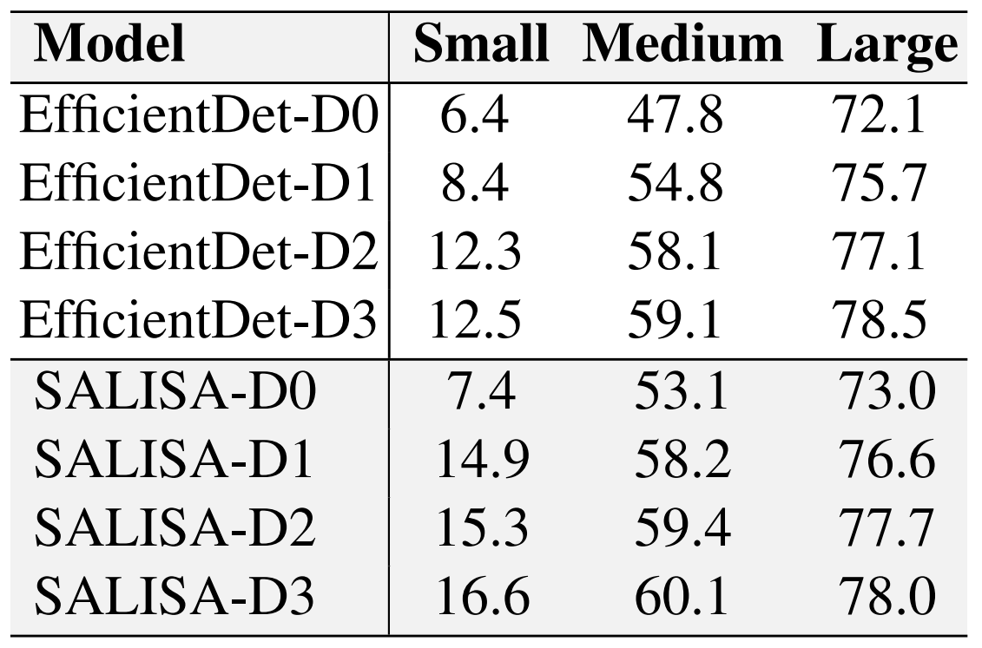
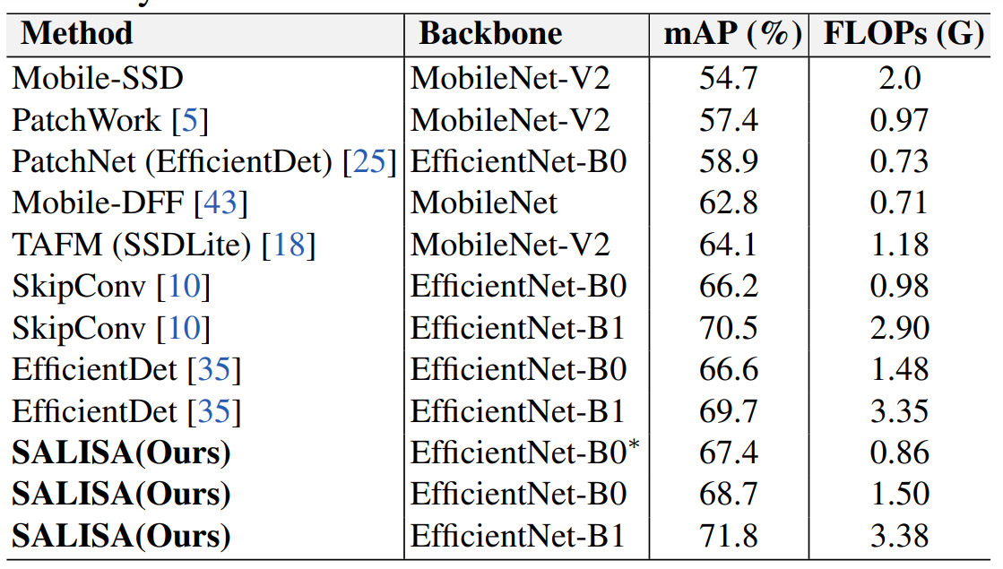
Evaluation
Video object detection benchmark
Consistently improves object detection accuracy
Small (0.04 GFLOPs) overhead for localization network
Significant increase in small objects
Outperforms state of the art

Slide 13
Temporal Redundancies
Reduce data
Reduce model
@Pixel
@Region
@Frame
@Block
@Backbone
FrameExit: Conditional Early Exiting for Efficient Video Recognition
Amir Ghodrati, Babak Ehteshami Bejnordi, Amirhossein Habibian
CVPR21

Slide 14
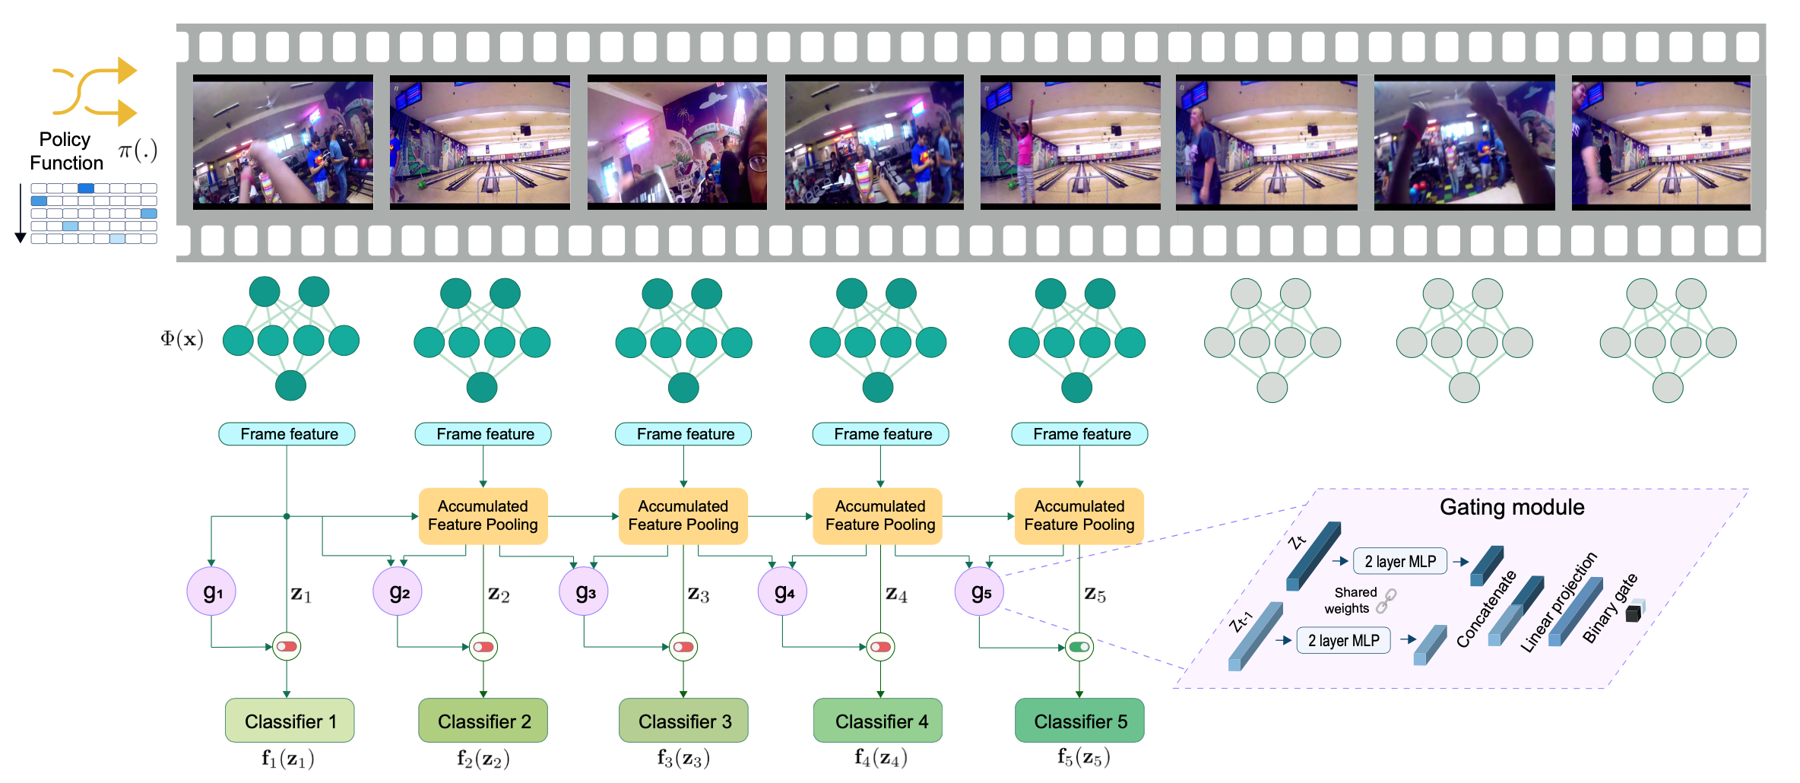
Efficient action recognition
Extend the early exiting idea for classification of images (over depth) to videos (over time)
Exit once the classification confidence is high or not increasing much by processing more

Slide 15
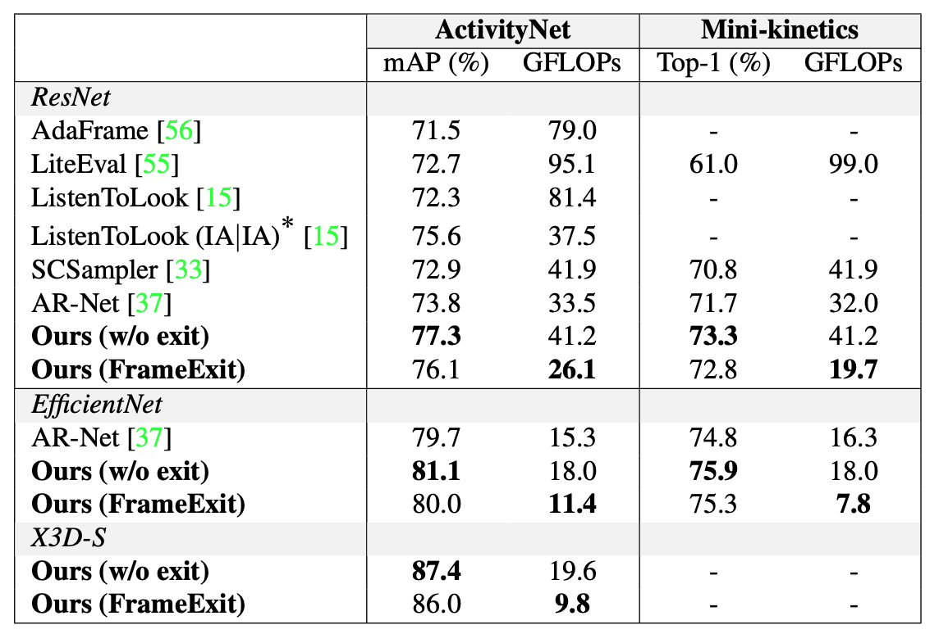
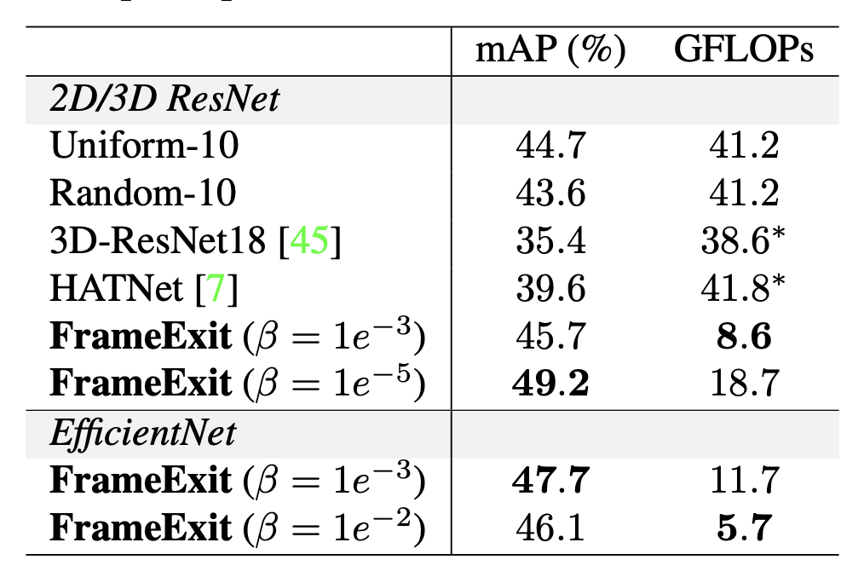
Results on ActivityNet, Mini-kinetics, and HVU
Holistic Video Understanding (HVU)
On all three datasets, FrameExit outperforms competing methods by obtaining higher accuracies with lower GFLOPs.

Slide 16
Temporal Redundancies
Reduce data
Reduce model
@Pixel
@Region
@Frame
@Block
@Backbone
Delta Distillation for Efficient Video Processing
Amirhossein Habibian, Haitam Ben Yahia, Davide Abati, Efstratios Gavves, Fatih Porikli
ECCV submission

Slide 17
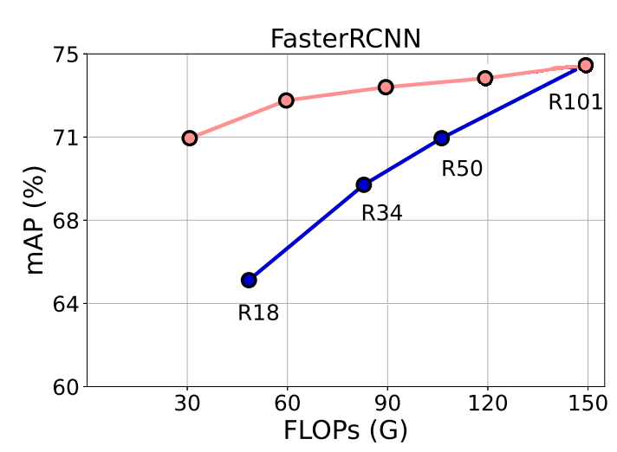
Acceleration by distillation
Distill an expensive network block by a cheaper one
Optimize the reconstruction error between features
Idea behind many model optimizations i.e., SVD, NAS
SVD: $f$ being each conv and $g$ being a decomposed kernel
Leverages the spatial and parameter redundancies
Minor accuracy drop for up to ~50% compression rate
Significant drop for high rates
$$f$$
$$g^{conv}$$
$$f$$
$$f$$
$$f$$
$$f$$
$$f$$
Conv2D
$$k×k×c$$
Conv1D
$$k×1×\frac{c}{γ}$$
Conv1D
$$1×k×c$$
$$c$$
$$ℓ(z,\tilde{z})$$
$$ℓ(z,\tilde{z})$$
$$ℓ(z,\tilde{z})$$
$$ℓ(z,\tilde{z})$$
$$ℓ(z,\tilde{z})$$
$$k$$
$$k$$
$$c$$
$$g$$
$$g$$
$$g$$
$$g$$
$$g$$
$$\frac{c}{γ}$$
$$k$$
$$k$$

Slide 18
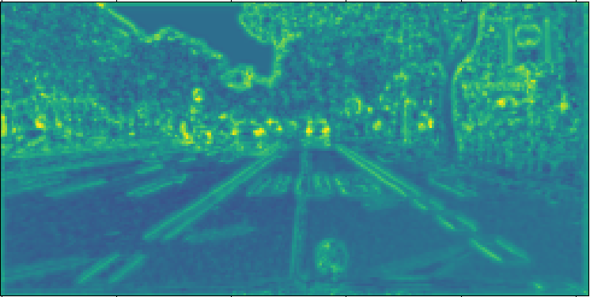
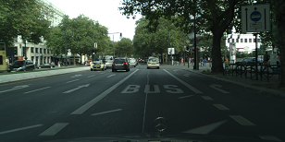
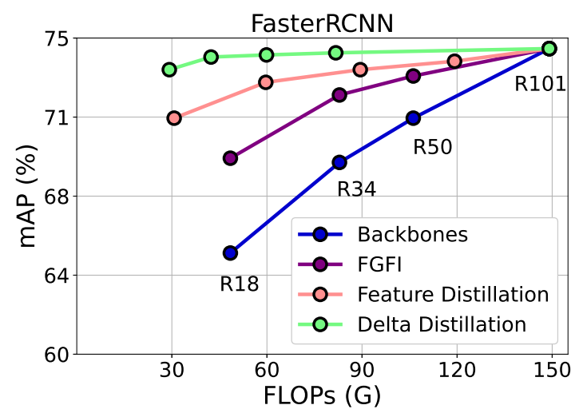
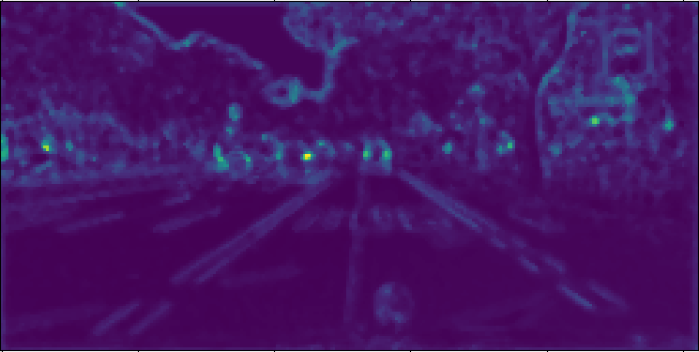
Delta distillation
Instead of reconstructing the features, reconstruct temporal changes (deltas)
Learn a smooth manifold generated by transitions between frames
Has a lower rank compared to features
i.e., Rank of zero for a static scene
More effective than distilling features
Feature Distillation
$$x_{t}$$
$$f$$
$$z_{t}$$
$$ℓ(z_{t},{\tilde{z}}_{t})$$
$$x_{t}$$
$$g$$
$${\tilde{z}}_{t}$$
Delta Distillation
$$f$$
$${Δz}_{t}$$
$$x_{t},x_{t−1}$$
$$ℓ(Δz_{t},{Δ\tilde{z}}_{t})$$
$$g$$
$$Δ{\tilde{z}}_{t}$$
$$x_{t},x_{t−1}$$

Slide 19
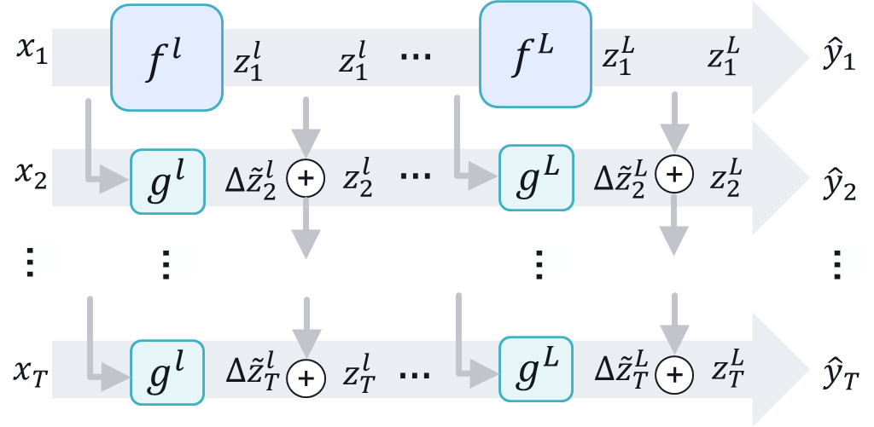
Delta distillation
Specify teacher blocks
Fine grained: each convolution
Coarse grained: sequence of ResBlocks
Both works! Coarse grained runs faster on device
Specify student blocks
Anything as long as its IO shapes matches the teacher
Channel scaling using pointwise convolution
Spatial scaling using resolution down/up sampling
Training objective:
= Delta distillation loss
+ Task loss
+ Gate loss to learn the optimal architecture
The both models are used at inference
Teacher: Extract features at key-frames only
Student: Extract deltas and update the features

Slide 20
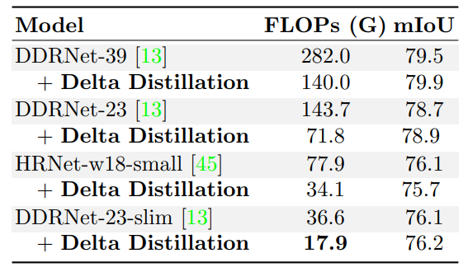
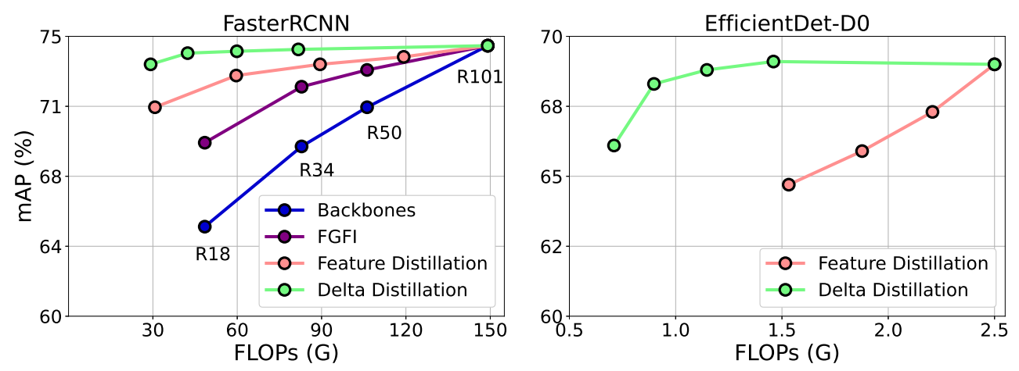
Results
Video Semantic Segmentation
Cityscapes benchmark
~2x reduction in FLOPs without loss
Consistently for HRNet and DDRNet
Video Object Detection
ImageNet VID benchmark
~2.5x reduction in FLOPs without loss
Consistently for FasterRCNN and EfficientDet

Slide 21
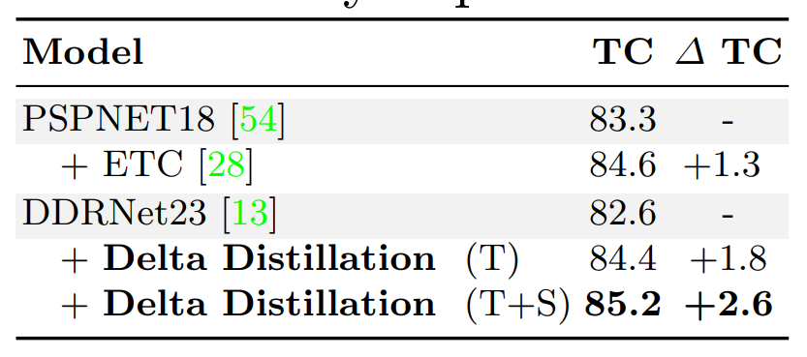
Results
T
T+1
T+2
Temporal consistency is improved
Regularizing the teacher to be more smooth
Outperforms models with explicit temporal consistency loss

